Slide 1
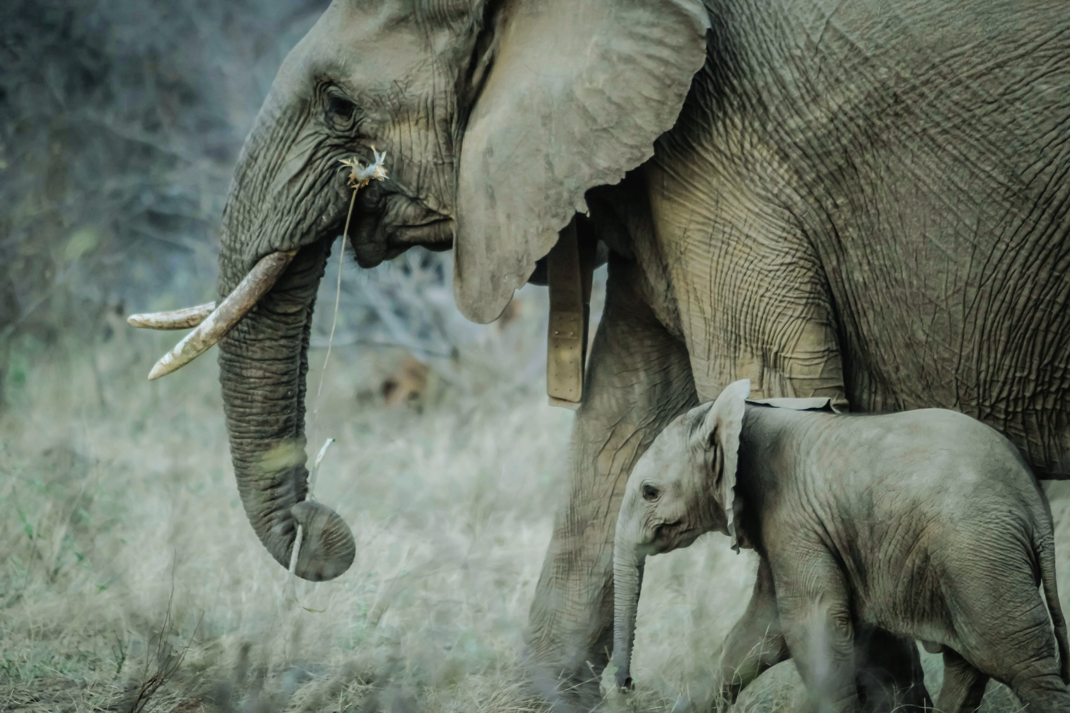
IoT Based Remote monitoring and Alerting of Human-Elephant Conflict Mitigation

Slide 2
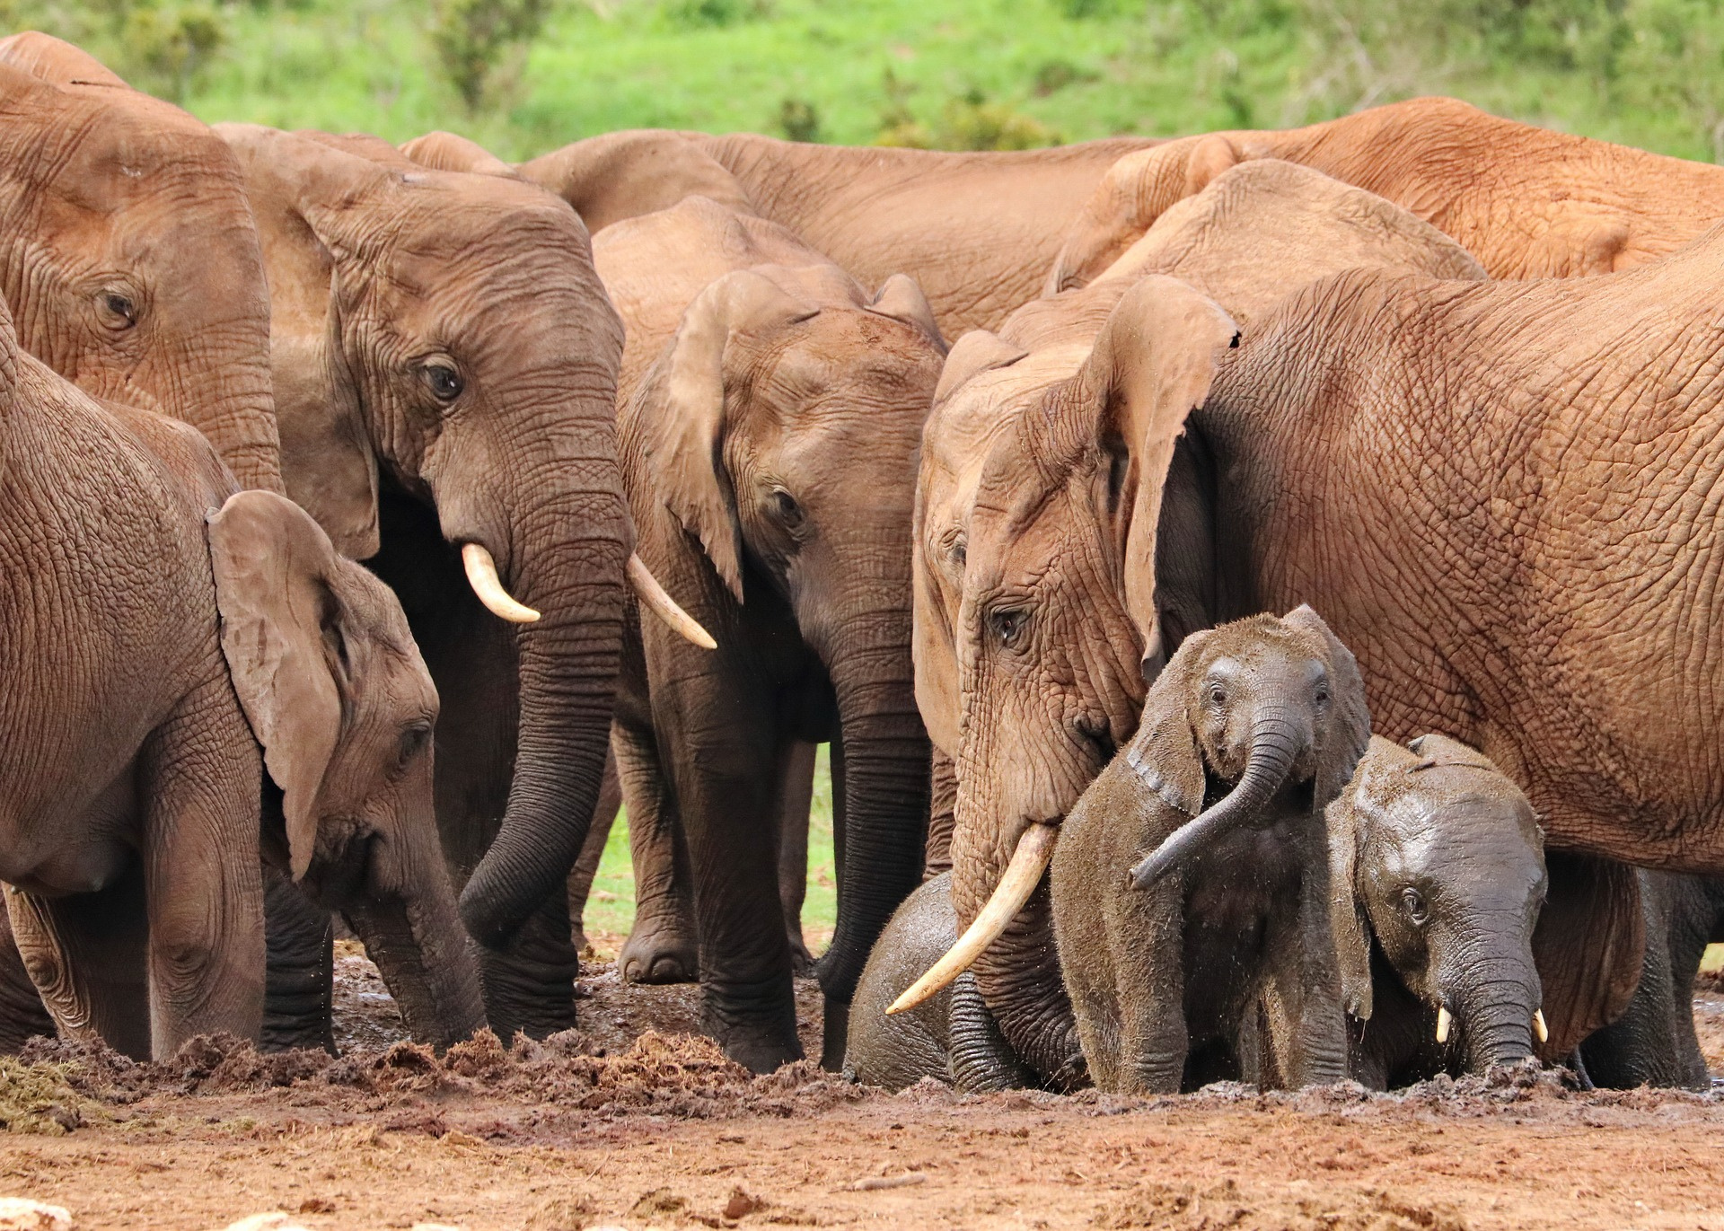
Technology Used :
Raspberry Pi, TinyML, Low-Cost Sensors
Real-Time Detection :
AI-enabled monitoring for accurate elephant identification
GSM :
Raspberry Pi, TinyML, Low-Cost Sensors
LoRaWAN :
AI-enabled monitoring for accurate elephant identification
Hybrid (GSM
+ LoRaWAN) :
AI-enabled monitoring for accurate elephant identification

Slide 3


Communication Systems for Human-Elephant Conflict (HEC) Mitigation
GSM (Global System for Mobile Communications)
Sends alerts via SMS & calls
Ideal for remote areas without internet
LoRaWAN (Long Range Wide Area Network)
Low-power, long-range wireless communication
Covers vast forested regions effectively
Hybrid GSM-LoRaWAN Model
Combines GSM & LoRaWAN for better coverage & reliability
Ensures redundancy in diverse terrains

Slide 4
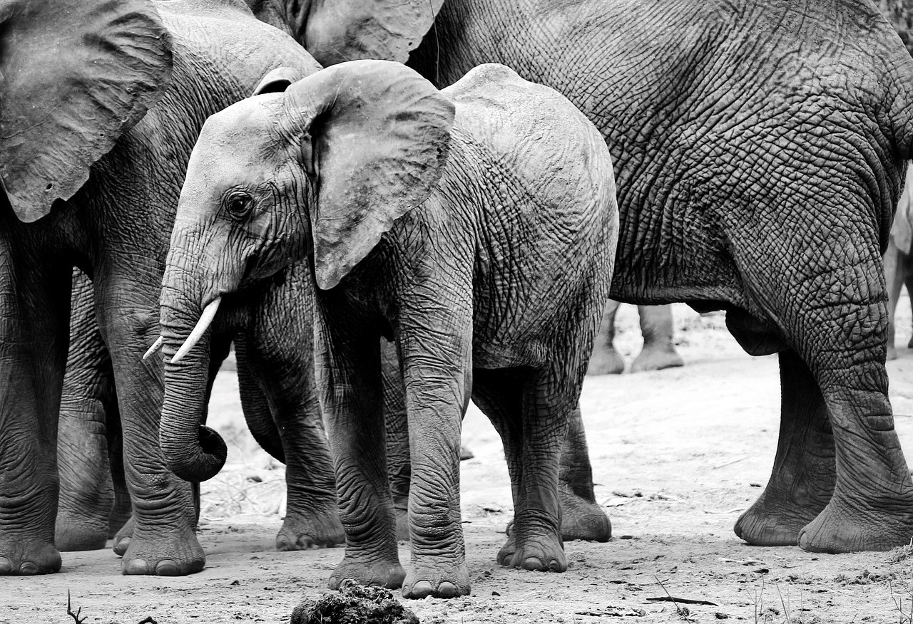


These models ensure seamless and timely communication for early warning and mitigation of HEC incidents.

Slide 5
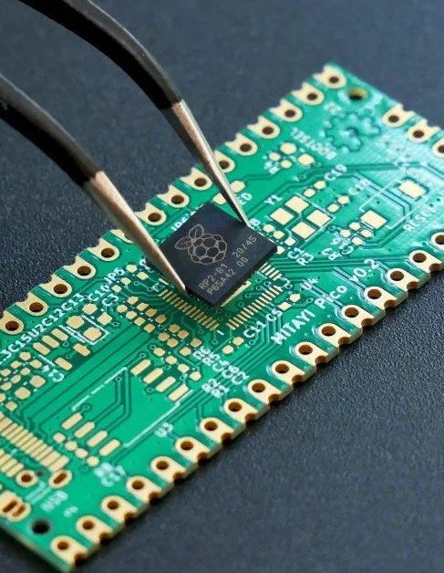
The advent of the Internet of Things (IoT) and advancements in machine learning, particularly TinyML, provide new opportunities for developing automated systems that can effectively address these challenges.

Slide 6
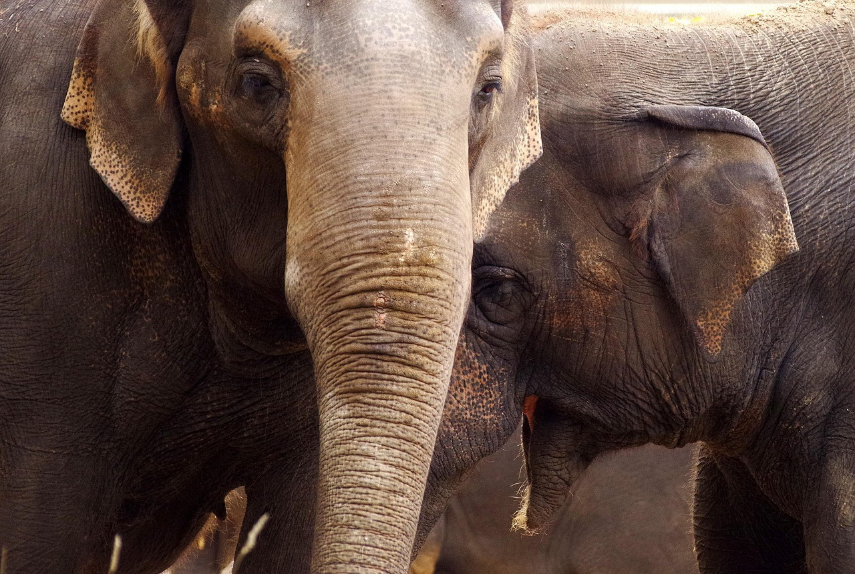



Elephant Detection
Energy Efficiency
TinyML for Human-Elephant Conflict (HEC) Monitoring
Real-Time Alerting
Edge Computing

Slide 7
Elephant Detection
Machine learning models analyze sensor data (e.g., infrared, acoustic, motion) to detect elephant presence.

Slide 8
Edge Computing
Processing data locally on Raspberry Pi reduces latency and minimizes reliance on internet/cloud services.

Slide 9
Energy Efficiency
TinyML enables low-power AI computations, making the system suitable for remote, battery-powered deployments.

Slide 10
Real-Time Alerting
Once an elephant is detected, the system immediately triggers alerts via GSM, LoRaWAN, or the hybrid model.

Slide 11
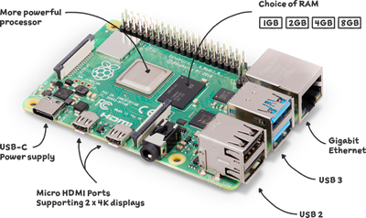
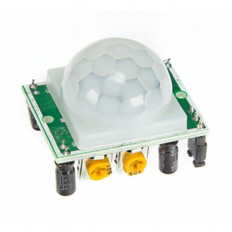
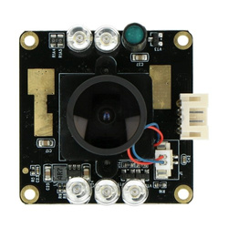
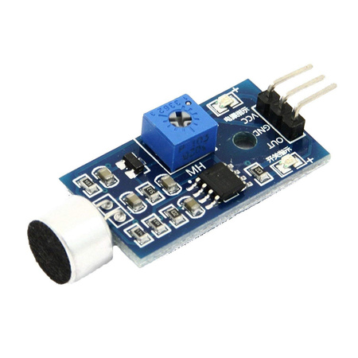
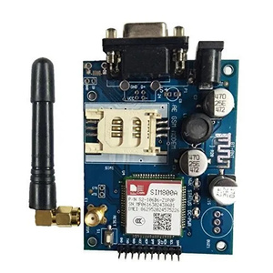
Component | Features | Reason of Choice
Raspberry Pi 4 Model B | Quad-core, Wi-Fi, GPIO support | Processing power and flexibility
PIR Motion Sensor | Detects motion within 7m | Low-cost and reliable
Camera Module V2 | 8MP resolution, night vision capability (IR) | High-quality image capture
Microphone Sensor | Sound frequency detection | Detects elephant calls
GSM Module | SMS and call support | Real-time alert notifications

Slide 12
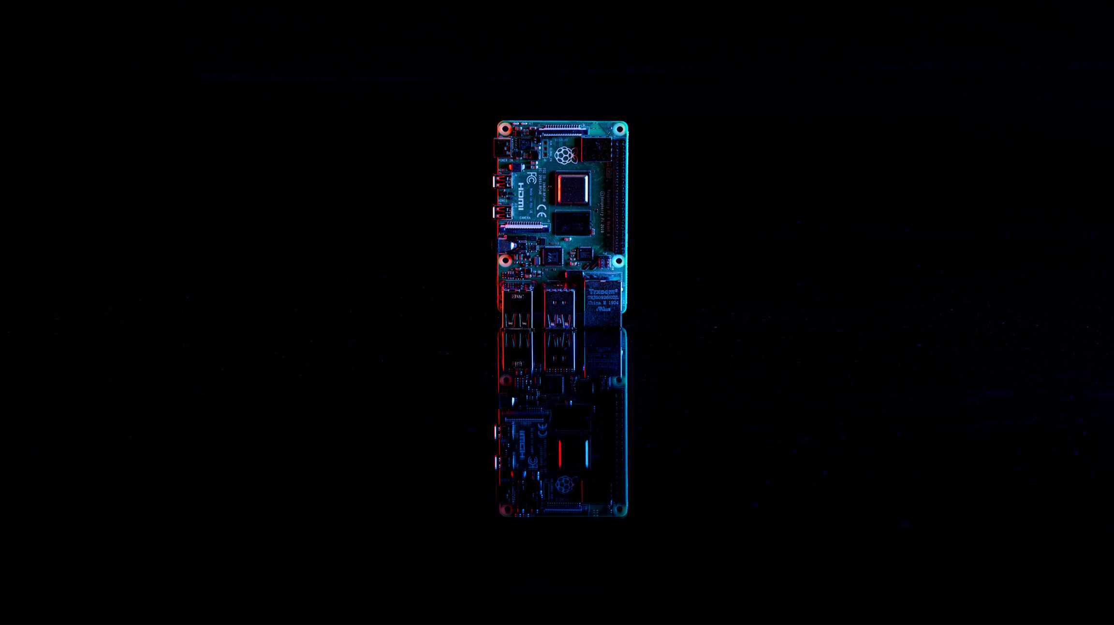
Why Raspberry Pi 4B Over Other MCUs?
🔹 Arduino Boards
Simple & easy to use ✅
Insufficient processing power for ML tasks ❌
🔹 STM32 Microcontrollers
Balanced computation & power efficiency ✅
Specialized programming & limited community support ❌
🔹 Raspberry Pi 4B (Optimal Choice)
High processing power for ML tasks ✅
Runs a full OS for scalability ✅
Strong community support for development ✅

Slide 13
🔹Compact, Power-Efficient & Cost-Effective
Smallest form factor with low power consumption
🔹 Supports Real-Time AI with TensorFlow Lite
Enables on-device ML processing with minimal computational load
More reasons to justify Pi 4B as the best pick?
🔹 Seamless Data Acquisition & Processing. Quad-core processor for smooth computation
Built-in Wi-Fi & GPIO support for connectivity
🔹 Peripheral Integration
GSM SIM800A → Sends alerts via SMS & calls
Arducam 1080p B0205 → Enables high-definition visual monitoring

Slide 14

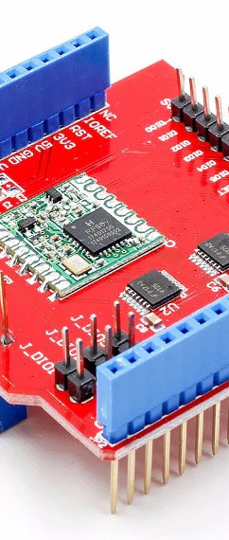
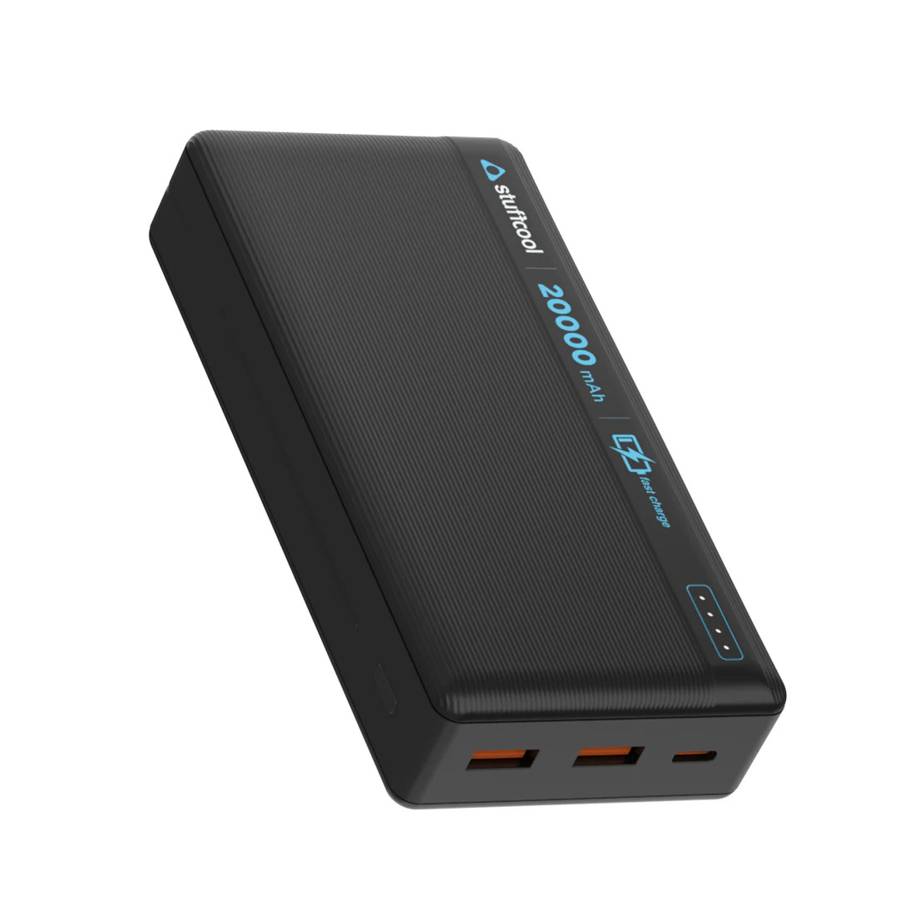
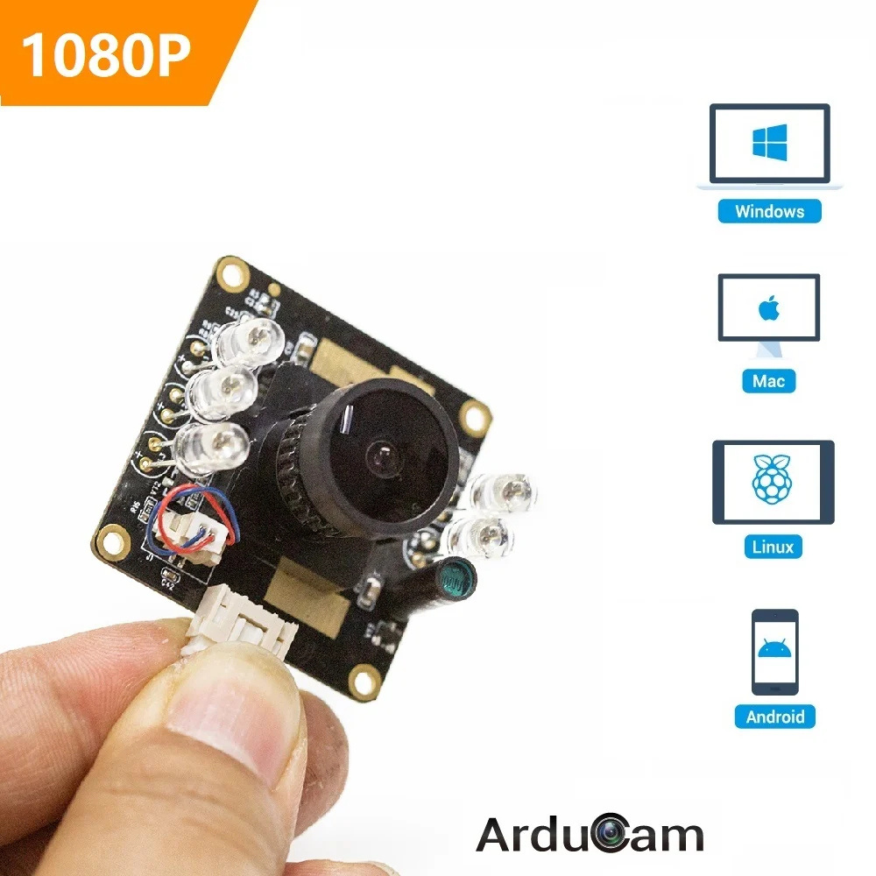
Arduino LoRa Shield
Facilitates long-distance communication 📡
Operates in regions without cellular networks
20,000mAh Power Bank
Ensures uninterrupted operation 🔋
Provides reliability during power outages
GSM SIM800A Module
Enables real-time SMS & call alerts 📲
Works even in remote areas without internet
Arducam 1080p B0205 Camera
High-definition imaging for visual monitoring 📷
Night vision for low-light data acquisition 🌙

Slide 15

Machine Learning Platform Selection
Challenge:
Running efficient ML models on limited-resource devices like Raspberry Pi
Evaluated Frameworks
Edge Impulse
Scikit-learn + TVM
TensorFlow Lite

Slide 16

Final Choice
TensorFlow Lite :
✅ High performance with optimized ML execution
✅ Pre-trained model support for rapid deployment
✅ Custom model flexibility for future enhancements
✅ Extensive documentation & active community for easy debugging

Slide 17
Model | CNN (Convolutional Neural Network) | SVM (Support Vector Machine) | YOLO (You Only Look Once)
Pre-trained Models Available | Yes | Limited | Yes
Custom Model Training | Yes | Yes | Yes
Computational Cost | High (for complex models) | Low to Medium | Medium to High
Memory Usage | Medium to High | Low to Medium | Medium to High
Suitable for Raspberry Pi | Moderate | High | Moderate
Focus | Classification | Classification | Object Detection
Model Evaluation and Selection:

Slide 18
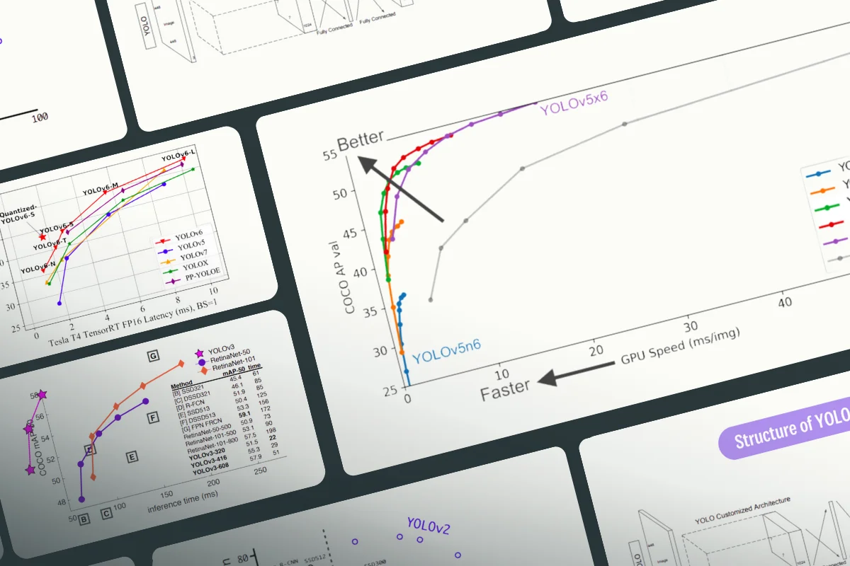
Challenges & Tradeoffs
Larger datasets needed for fine-tuning YOLO’s accuracy
Balance between speed and accuracy, but YOLO's versatility makes it the best choice for mitigating HEC

Slide 19

Supports edge computation on Raspberry Pi without requiring cloud infrastructure 🌍
Reduced latency ensures timely detection and alerting 🕒
Scalable for resource-constrained environments, ideal for remote wildlife monitoring 🌲
YOLO (You Only Look Once)
Raspberry Pi OS

Slide 20
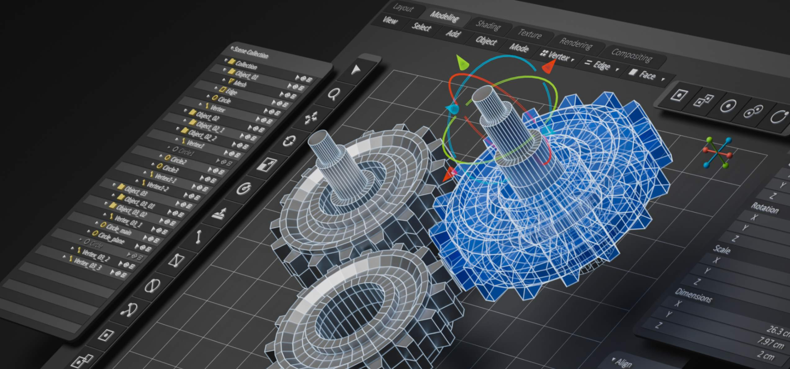
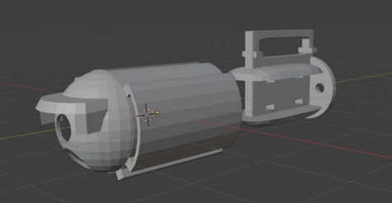
3D Printed Models for Practicality
🔹 Purpose
Housing and shielding for sensors and electronics
Modular design for easy installation and upgrades
🔹 Material: PLA
Durable, lightweight, and biodegradable
Weather-resistant for reliable performance in the field
🔹 Benefits
Cost-effective and easy to print
Ensures sustainability and serviceability

Slide 21
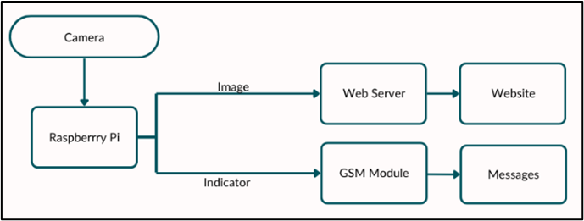
Model 1: GSM-Based System

Slide 22
Model 1: GSM-Based System
🔹 Communication
GSM module for SMS/calls in areas with no/low internet
SMS/Voice alerts sent to relevant authorities and communities
🔹 Components
Camera & Raspberry Pi: Capture and analyze images for elephant detection using TinyML
Web Server: Displays processed images for visual monitoring
🔹 Functionality
Alert system: Detects abnormalities and sends immediate alerts to stakeholders
This model ensures reliable communication and real-time action in remote areas.
4o mini

Slide 23
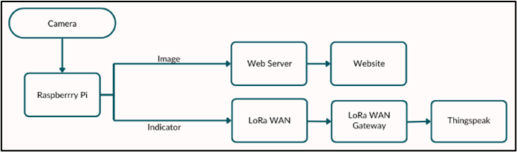
Model 2: LoRaWAN-Based System

Slide 24
Model 2: LoRaWAN-Based System
🔹 Communication
LoRaWAN technology for long-range, low-power alerts across vast forest areas
Data is relayed through a LoRaWAN gateway to a central server for monitoring
🔹 Components
Camera & Raspberry Pi: Captures and analyzes images for elephant detection using TinyML
LoRaWAN Module: Sends detection data to the LoRaWAN gateway
Cloud Integration: Data is uploaded to Thingspeak/web platforms for remote monitoring
🔹 Functionality
Efficient for large areas with minimal power consumption
Real-time alerts & monitoring for enhanced HEC mitigation

Slide 25
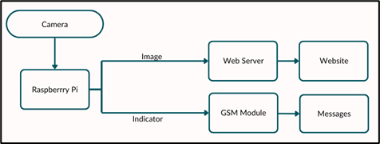
Model 3: Hybrid GSM & LoRaWAN System

Slide 26
Model 3: Hybrid GSM & LoRaWAN System
🔹 Communication
Combines GSM & LoRaWAN for enhanced coverage & reliability
Immediate alerts via GSM (SMS/calls) + Long-range data transmission via LoRaWAN
🔹 Components
Camera & Raspberry Pi: Detects elephants using TinyML, processes images, and sends them to a web server.
GSM & LoRaWAN Modules: Ensures real-time local & remote alerts for faster response
LoRaWAN Gateway & Cloud Integration: Data is transmitted to Thingspeak & web platforms
🔹 Functionality
Immediate notifications for local response via GSM
Scalable monitoring for large areas via LoRaWAN
Centralized real-time data access via web & cloud platforms

Slide 27


Slide 28

Hardware Setup & Model Deployment
🔹 Camera + Raspberry Pi: Captures & processes images
🔹 GSM / LoRaWAN / Hybrid Model: Communication modules integrated
🔹 TinyML Model Training:
Dataset trained for elephant detection
Optimized for real-time processing on Raspberry Pi

Slide 29

Communication & Web Server
🔹 GSM & LoRaWAN Configurations:
GSM: Sends alerts via SMS & calls
LoRaWAN: Long-range data transmission to the cloud
Hybrid: Combines both for redundancy & extended coverage
🔹 Web Server & Cloud Integration:
Live image & alert visualization on a web interface
Cloud platforms like Thingspeak for storage & analytics

Slide 30

Communication & Web Server
🔹 System Calibration & Testing:
Fine-tuned model & communication setup
Eliminating false positives for reliable alerts
🔹 Real-world Deployment:
Deployed in forested areas prone to human-elephant conflict
Continuous monitoring & iterative improvements

Slide 31

Performance & Results
🔹 Elephant Detection Accuracy: 97.1%
🔹 Zero false positives, ensuring reliable threat detection
🔹 Battery Life: 7+ hours of continuous operation
🔹 System Validation: Successfully tested in real-world environments

Slide 32
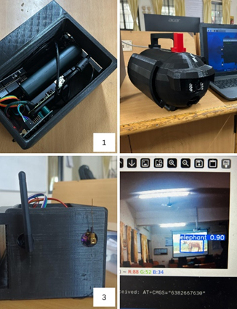
CONCLUSION & FUTURE SCOPE
This IoT-based system uses TinyML, GSM, and LoRaWAN to detect elephants and reduce human-elephant conflicts. The hybrid model improves coverage and reliability, achieving 97.1% accuracy with 7+ hours of battery life. Future enhancements include environmental sensors and STM32 microcontrollers for better efficiency, making it a scalable solution for global wildlife conservation.

Slide 33
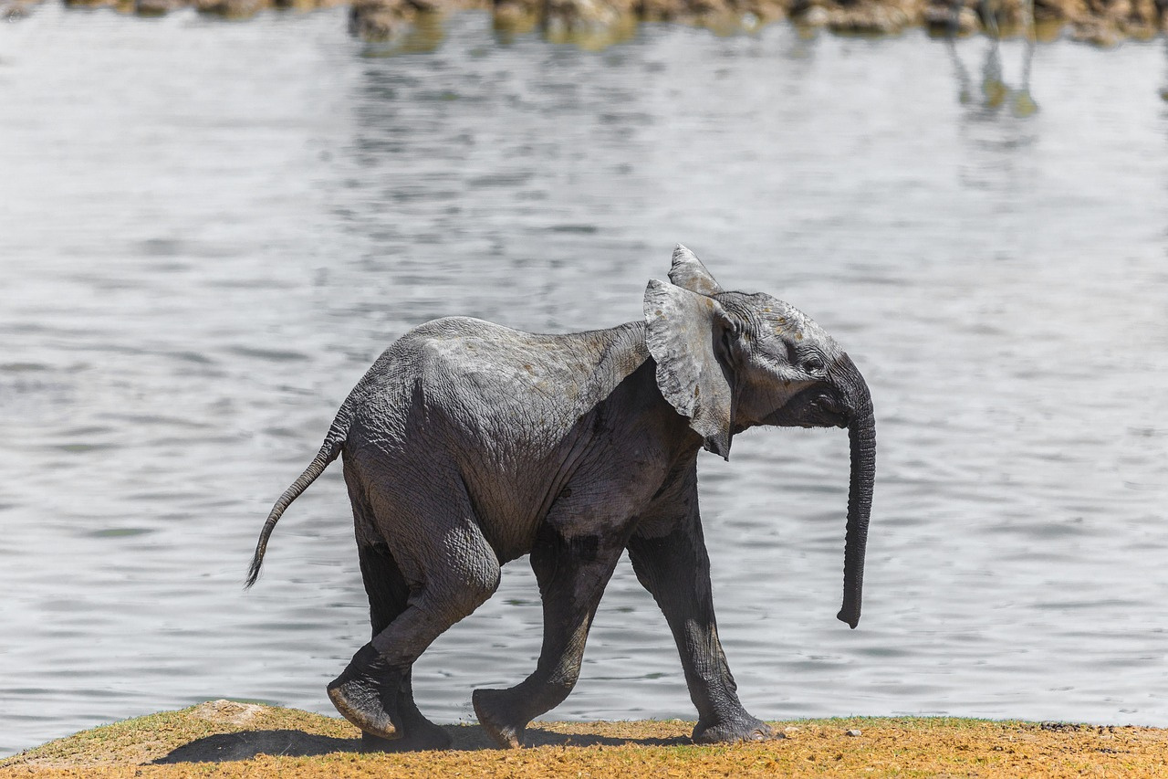
Thank You

